Slide 1
English-Greek General Language Dictionary
LexMC - reporting

Slide 2
English-Greek Dictionary: Initial Goals
Convert source files to xml
Create syntactically correct xml files and manage format challenges, e.g. character encoding
Ensure correct format and consistency when editing/ correcting/ proof-reading

Slide 3
Grobid Dictionaries
Sample (dummy) models
Model creation
Web service - Visualisation of the output
English – Greek Dictionary (16 pages)
Generation of training data for 4 models
Models creation and output visualisation

Slide 4
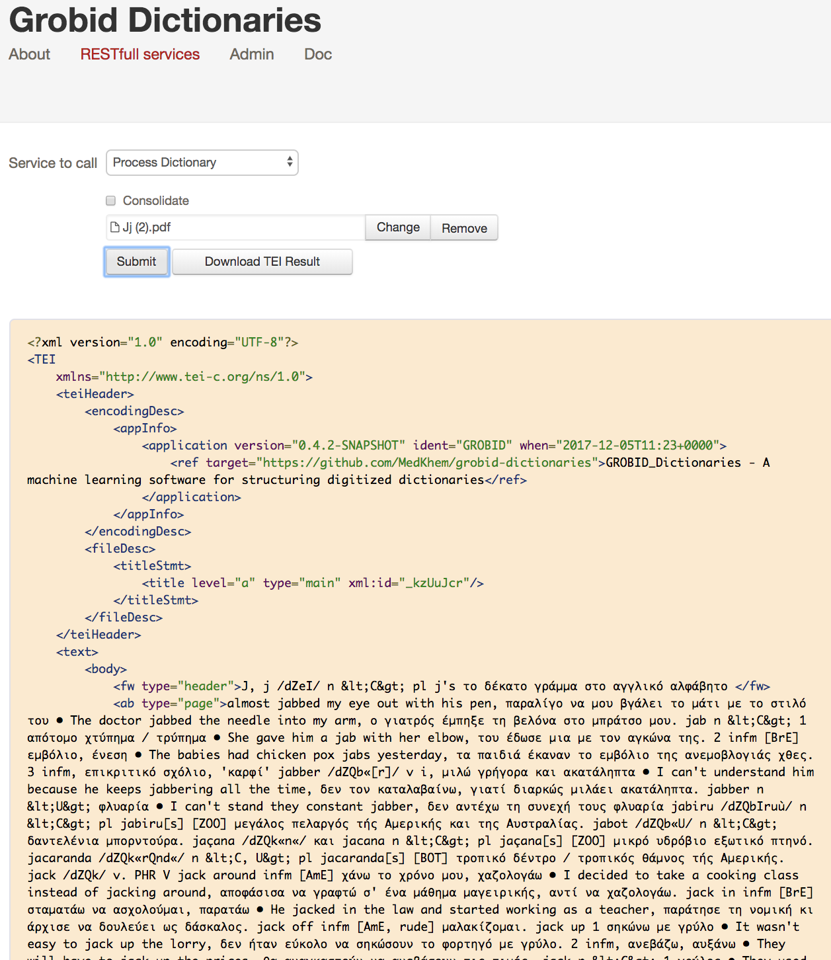
1. Dictionary segmentation
Headnote
Body
dictScrap

Slide 5
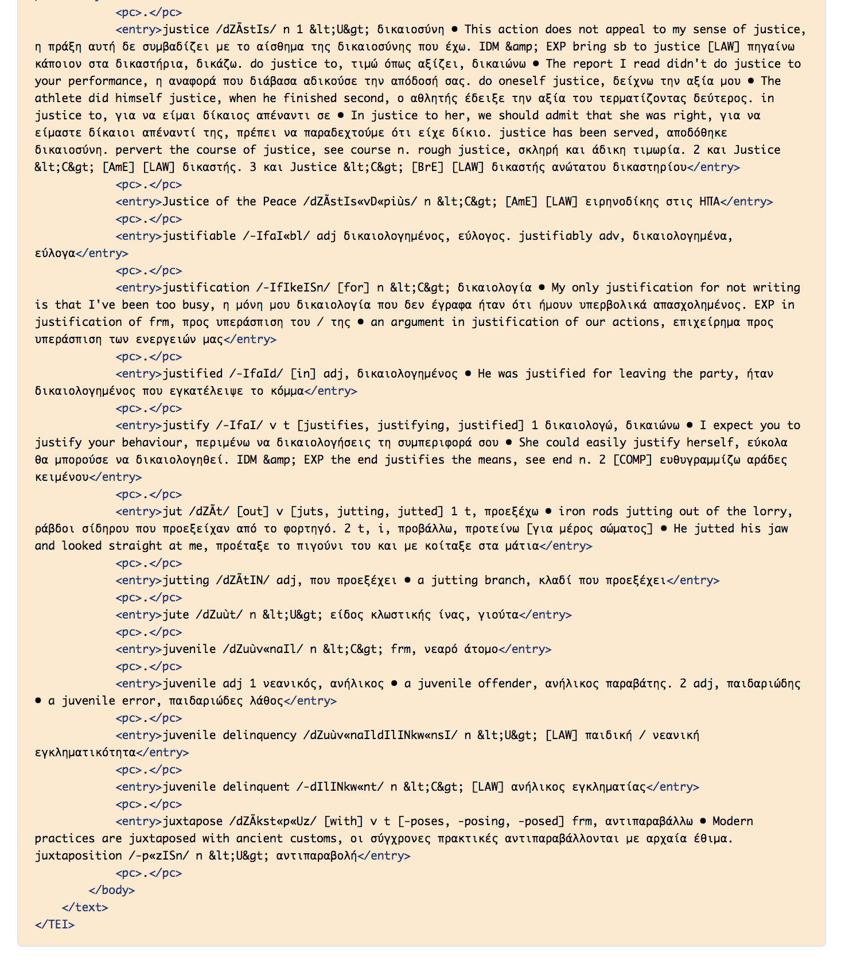
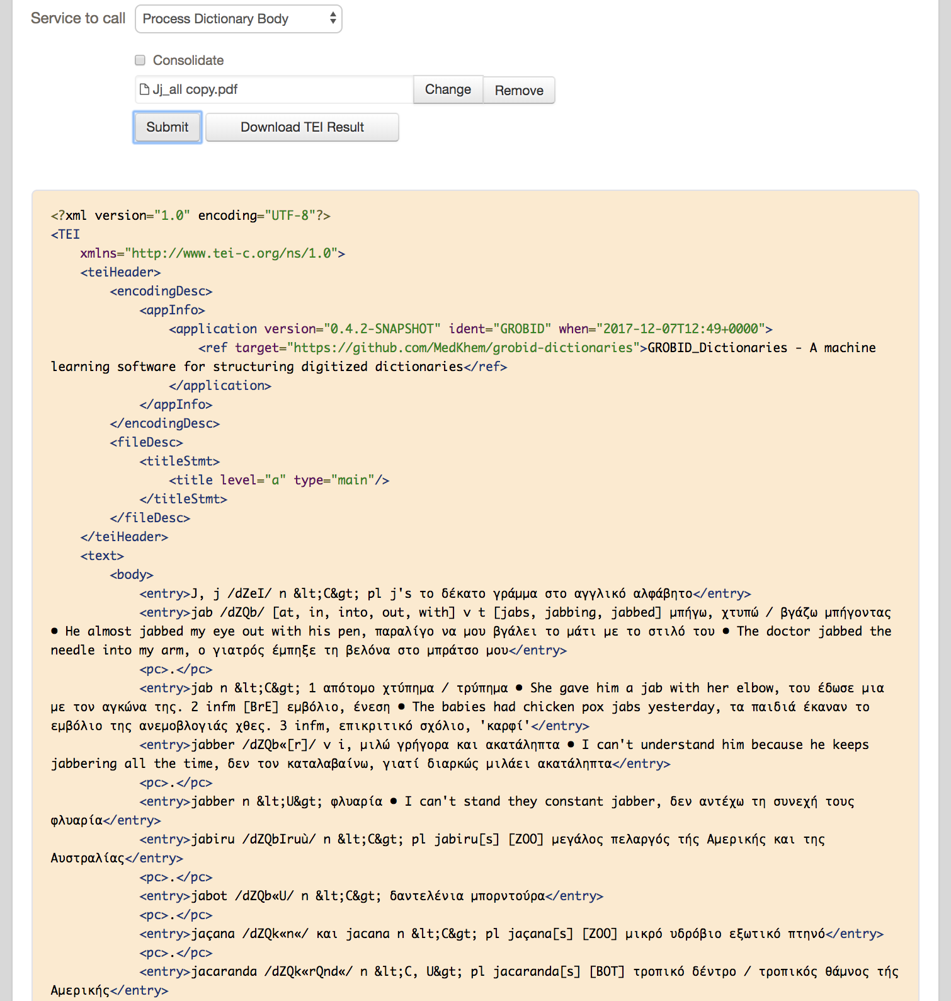
2. Dictionary Body Segmentation (Entry)

Slide 6
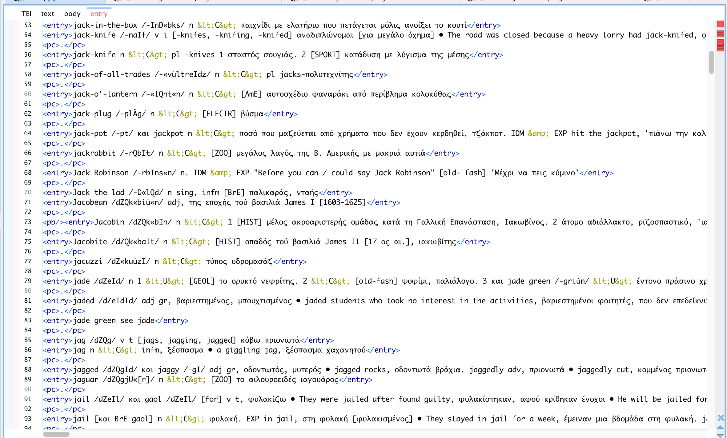

Slide 7
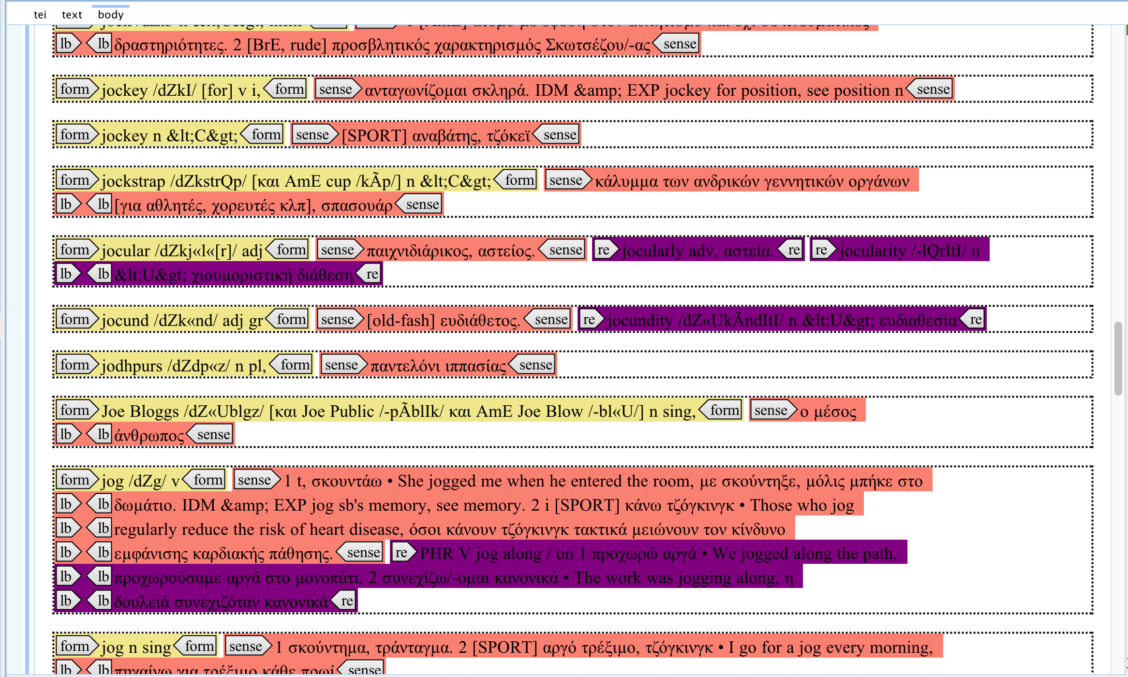
3. Lexical Entry model
Form
Sense
Related Entry

Slide 8
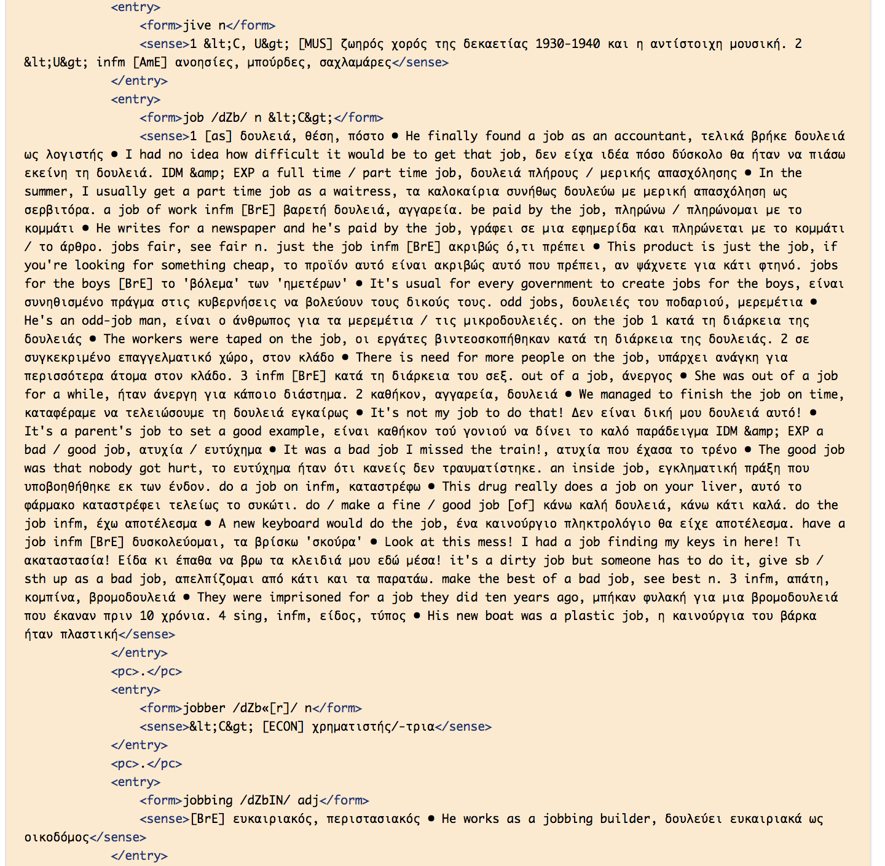

Slide 9
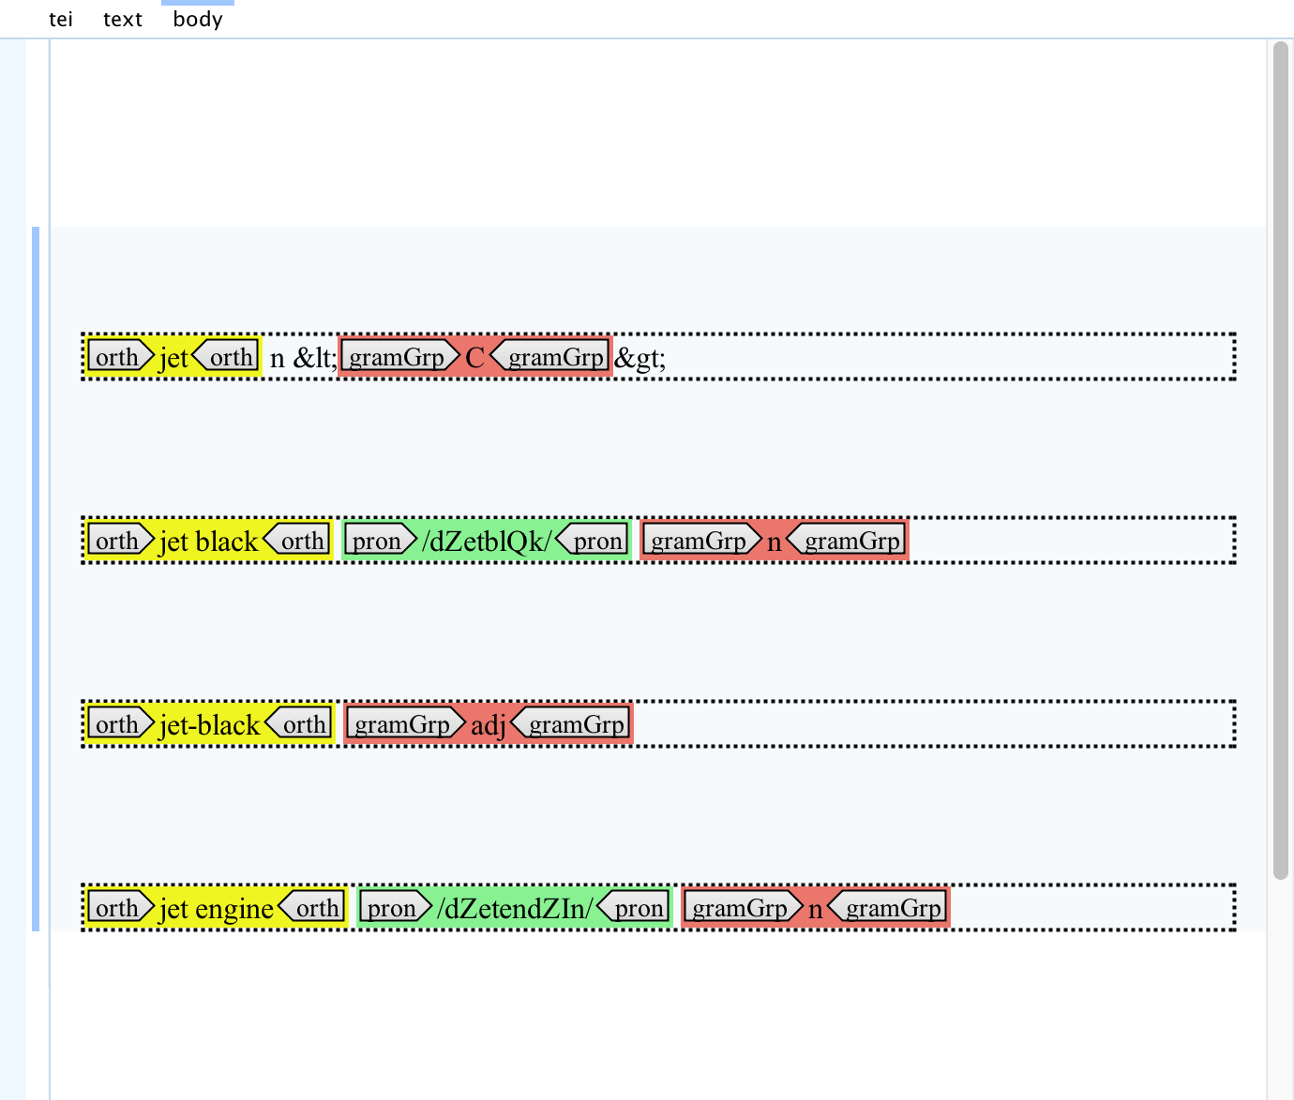
4. Form model
Orthography
Pronunciation
POS

Slide 10
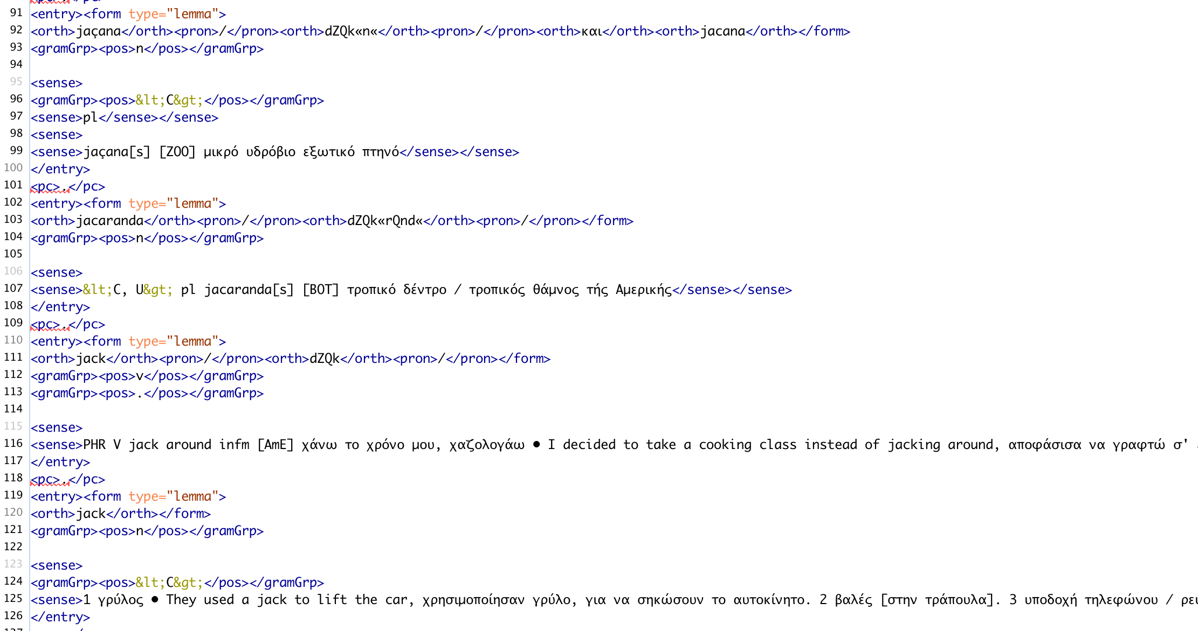

Slide 11
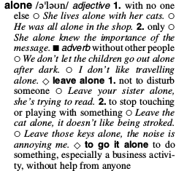
Challenges & Opportunities
Related entries and sense annotation: no clear definition, not yet determined in which level they should be annotated.
Angle brackets (POS) in the dictionary file are mistaken for TEI symbols
User-friendly workflow
Easily trainable with relatively little data
The incorporation of more TEI elements at sense level will make this a valuable service for semi-automatic dictionary digitisation

Slide 12
Data Management Plan
Creation of sample template at DMPonline

Slide 13
THANK YOU!

